Slide 1
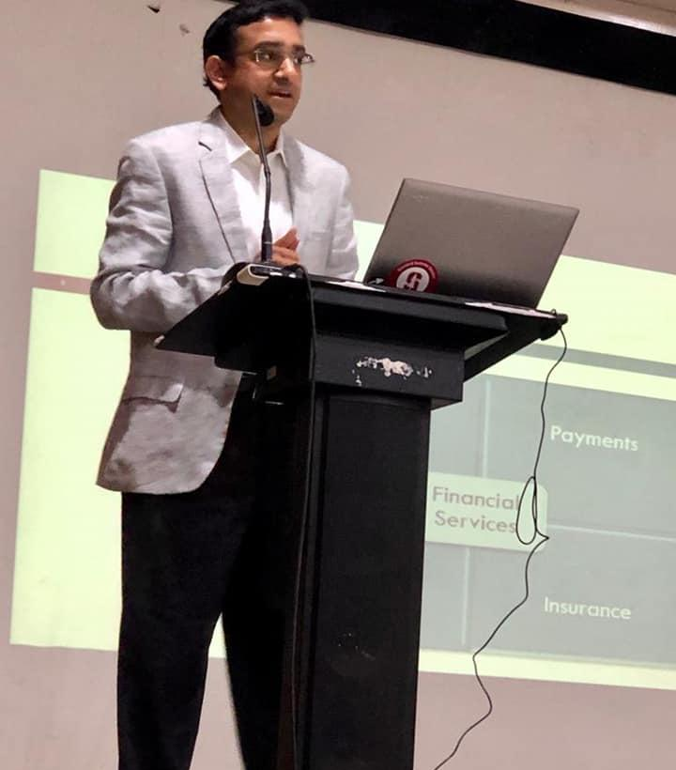
INSIGHT 23rd August, 2019
A glimpse into the world of Finance & Investments – Mr. Rajan Chandrashekharan (Head – Risk & Financial Alignment, Aspire Standard Chartered Bank)

Slide 2
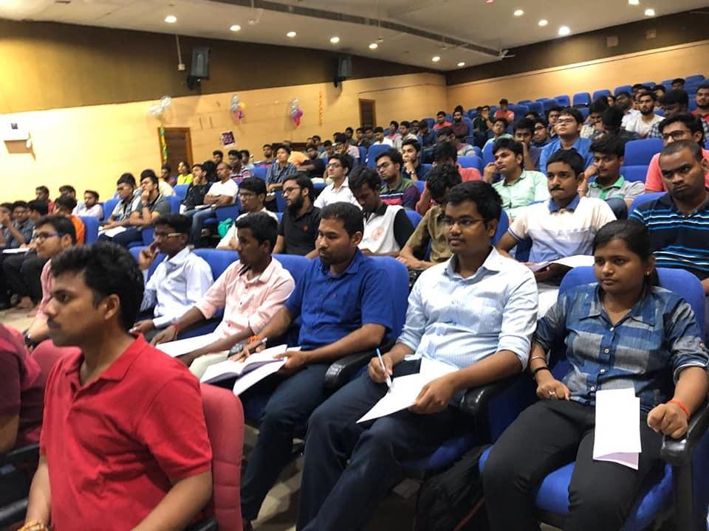
INSIGHT 23rd August, 2019
Conducted in association with the Alumni Institute Interaction Cell, NIT Trichy.
Introducing financial services and the disrupting impact of technology on the financial industry.
Open interaction with 1994 batch NITT Alumni.

Slide 3
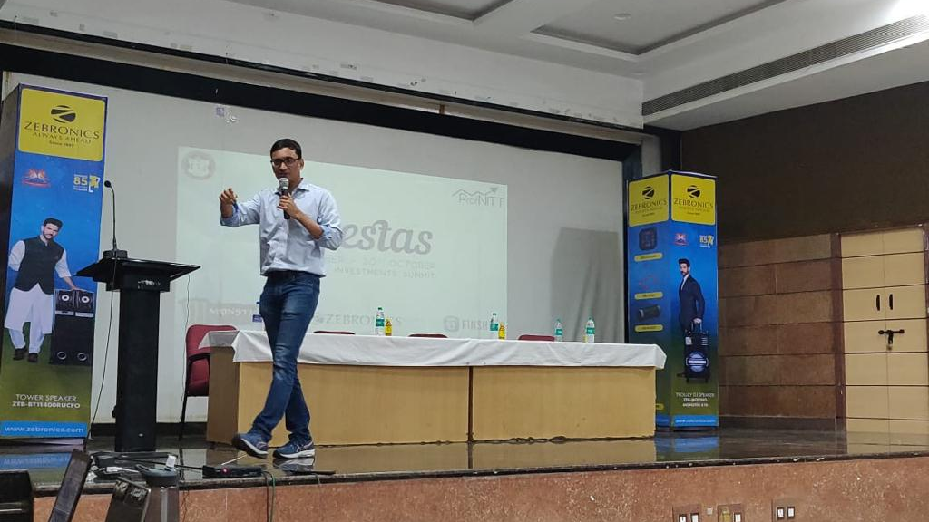
INVESTAS’ 19
16th - 18th October 2019
The second edition of our annual flagship summit.
A three-day extravaganza, revolving around the theme of finance and investments.
Series of engaging events, challenging competitions, interesting and knowledgeable guest lectures.

Slide 4
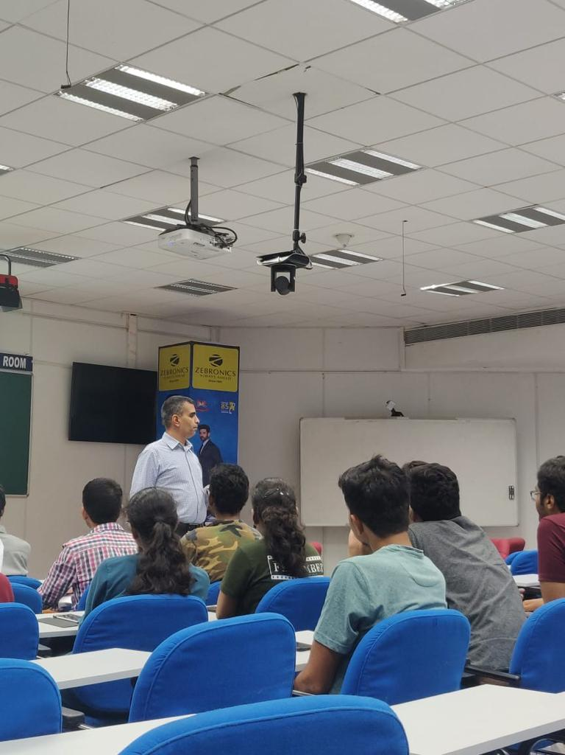
INVESTAS’ 19
16th - 18th October 2019
Chief Guest Speech on Finance as a Career – Mr. Rajan Singh (CEO-Concept Owl, Ex-IPS, Ex-McKinsey, MBA-Wharton)
Case Study on Mergers & Acquisitions – Mr. Aditya Somani (Ex-VP at Private Equity at Premji Invest)
Lecture on Leveraging Technology Effectively in Finance – Mr. Sridhar Gopal (Head of Technology, Hedge Funds, Wells Fargo)
VC Talks: An Insight into the world of Venture Capitalism – Mr. Ganesh Iyer (CEO-Symphony Ventures)
Lecture on Stocks & Derivatives – Mr. Sivakumar S (Vice President-Citi Bank)
GUEST LECTURES

Slide 5
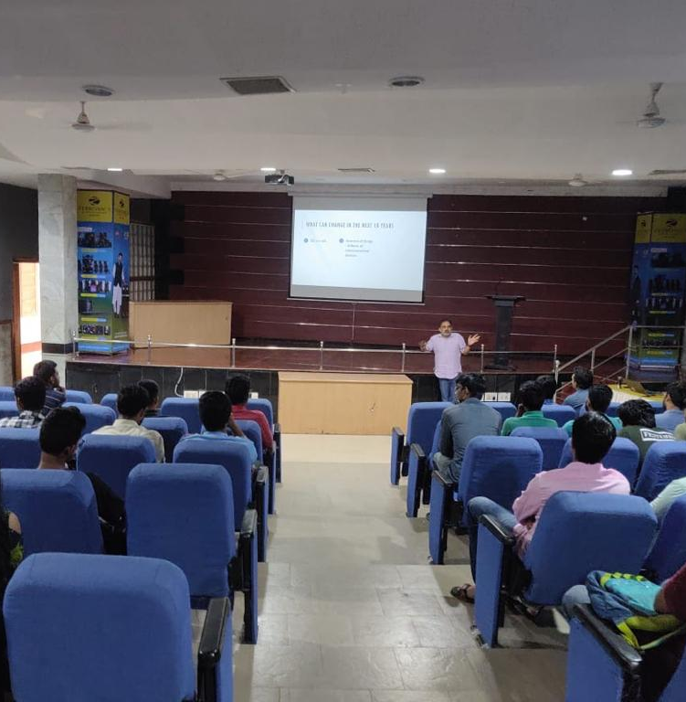
INVESTAS’ 19
16th - 18th October 2019
EVENTS & COMPETITIONS
Money Heist – A week-long online trading contest (14th - 18th October). Conducted in association with Stock Trainer App, the No.1 Online Virtual Trading App on Google Play Store.
Analytix – An open event conducted during Investas. Participants were given insights of using and analyzing data to make impactful business decisions.
Case In-Point – An open Case Study Challenge. The problem statement was provided to student teams on-spot. The solutions were judged by Mr. Aditya Somani (also our Guest Speaker).

Slide 6
INVESTAS’ 19 16th - 18th October 2019
MARKETING PARTNERS
Organized in association with:
Zebronics as our Audio Partner
KFC as our Food & Refreshments Partner
Monster Energy as our Energy Partner
Finshots as our Online Content Partner
Stock Trainer App as our Online Trading Partner
FOOD STALLS
Dominos Pizza
The Lassi and Falooda Shop

Slide 7
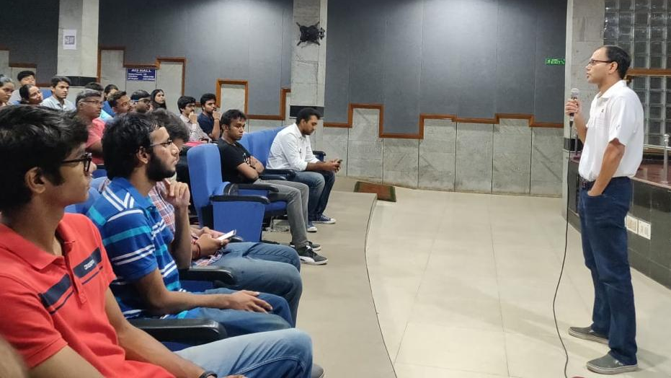
THE TALK 12thNovember, 2019 On-Campus Interaction (Open to all) – Mr. Rama Variankaval (Managing Director at J.P. Morgan New York)

Slide 8
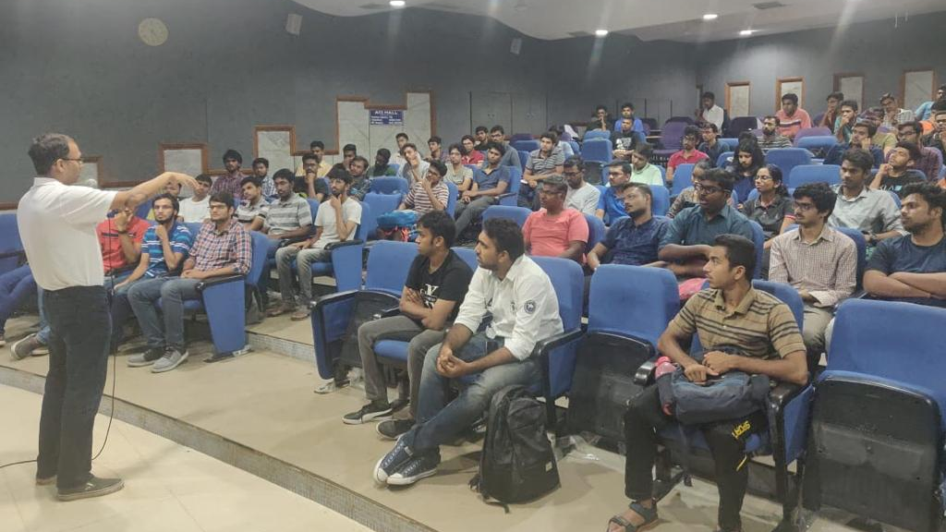
THE TALK - 12thNovember, 2019
Conducted in association with the Technical Council, NIT Trichy.
Interaction with Students of NIT Trichy, from all years.
Insights provided into intriguing world of finance.
The chaotic, thriving lifestyle of a trader at Wall Street.
Open interaction and exchange of experiences between students and the speaker.

Slide 9
THE ORACLE IN FINANCE 28th January, 2020 – Mr. Prasanna Mathiannal (Director and Senior Trader at Standard Chartered Bank, Honk Kong
Discussion on various domains of finance (risk management, valuations, corporate finance, etc.)
A more in-depth look and industry-oriented take on the concepts
One-to-one interaction with students, from B.Tech Freshers to MBA Students.

Slide 10
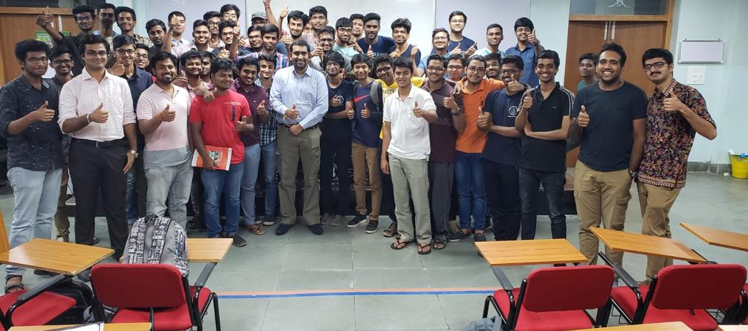
THE ORACLE IN FINANCE (28th January, 2020)

Slide 11
FROM WANNABE TO TRADER ^{24th} January, 2020 – Workshop Conducted By Members of ProfNITT
Conducted in association with Pragyan – NIT Trichy’s Techno-Managerial Organization, as part of Workshops in Pragyan InHOTTS.
Participants were tutored on understanding stocks, shares and the physical meaning these hold.
Students were made to explore trading techniques used in industry.
Participants were shown how to understand and comprehend balance sheets, and how to use them, in comparative study of two organizations, to make the right trades, on-spot.

Slide 12
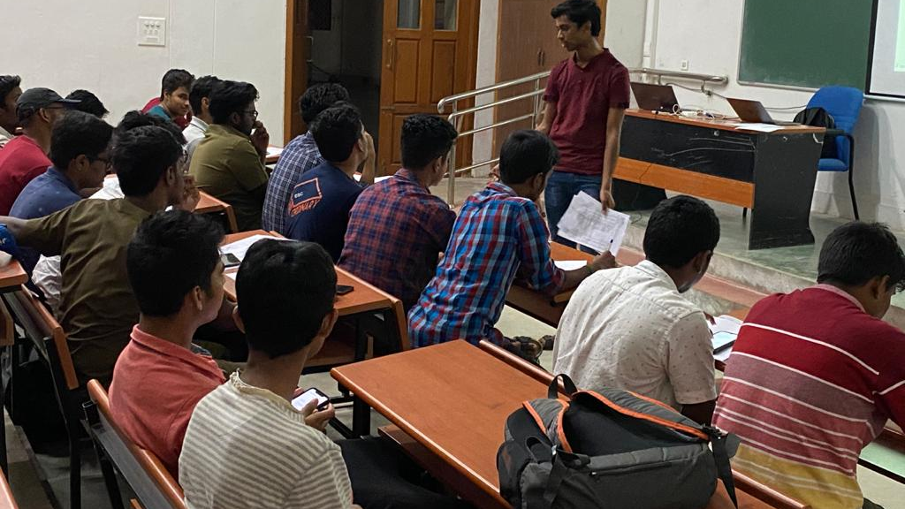
FROM WANNABE TO TRADER ^{24th} January, 2020

Slide 13
Other Activities
Student Trading Fund: Market analysis, formulizing professional Stock Reports, and executing trades as per the same.
BharatX – Our Campus Development FinTech Project: A UPI payment app integrated with NITT E-Vaahan ride hailing services for the students of NITT.
Articles for Financial Literacy: Published on The ProfNITT Medium Blog Page, dealing basic concepts of finance explained in the simplest of ways – improving financial literacy of students.
Social Media Interactions: As part of Talentine Initiative of the Student Council, we as a club went on to entertain the students through interesting and hilarious memes during this tough times of COVID-19 Lockdown.

